Slide 1

22년 삼성 AI 전문가과정
6월 9일 목요일 5교시
장병탁
인공지능
20차시 : Robotics
서울대학교 컴퓨터공학부
담당 교수: 장병탁
Seoul National University
Byoung-Tak Zhang

Slide 2
Lecture Overview
인공지능
20차시 : Robotics
서울대학교 컴퓨터공학부
담당 교수: 장병탁
Seoul National University
Byoung-Tak Zhang

Slide 3
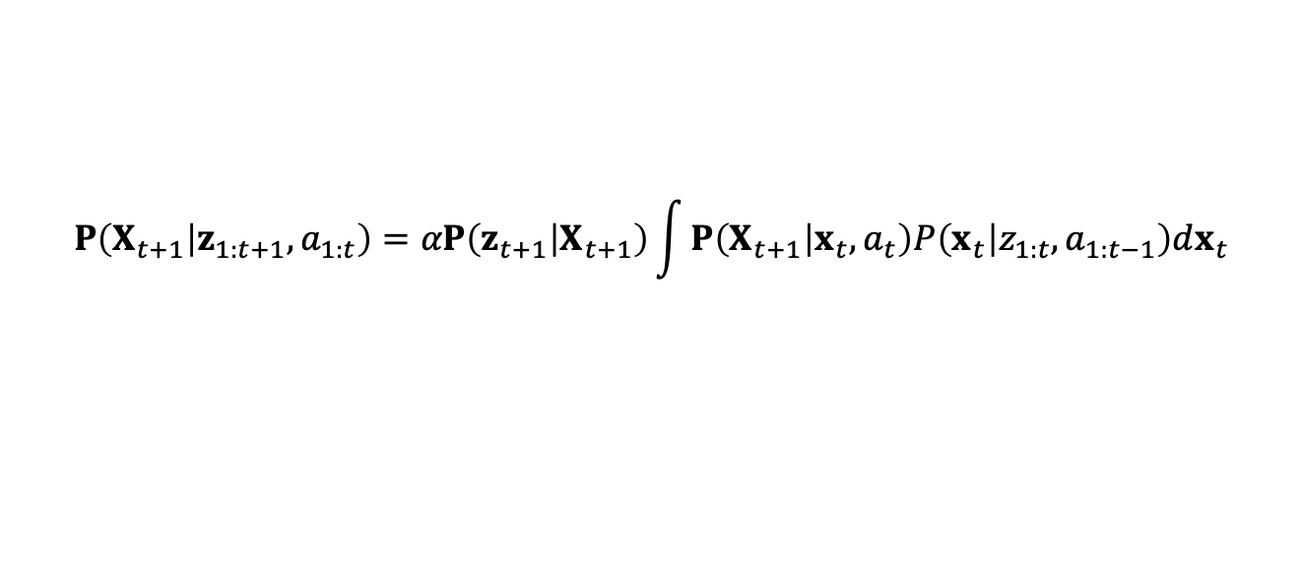
Introduction: Robotics
Robots are agents endowed with
Sensors that perceive their environment
Effectors that assert physical forces on the environment
Robots are physical agents that
are equipped with sensors and effectors and
perform tasks by manipulating the physical world.
Robots operate in environments that are
partially observable and stochastic
usually under continuous state space
$$P\left(X_{t+1} | z_{1:t+1},a_{1:t}\right)=αP\left(z_{t+1} | X_{t+1}\right)\int{P\left(X_{t+1} | x_{t},a_{t}\right)P\left(x_{t} | z_{1:t},a_{1:t−1}\right)dx_{t}}$$

Slide 4
Types of Robots
Manipulators
Robot arms physically anchored to their workspace
Mobile robots
Move about their environment using wheels or legs
Mobile manipulators
Combine mobility with manipulation

Slide 5
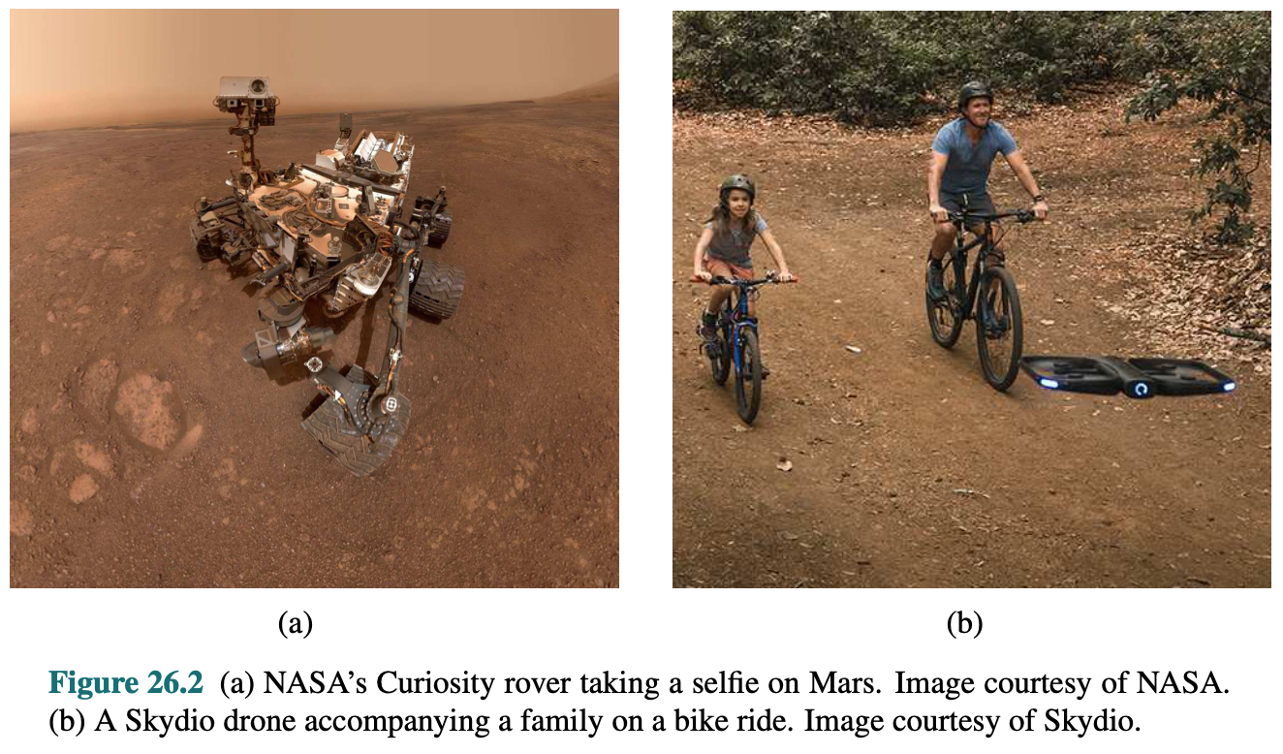
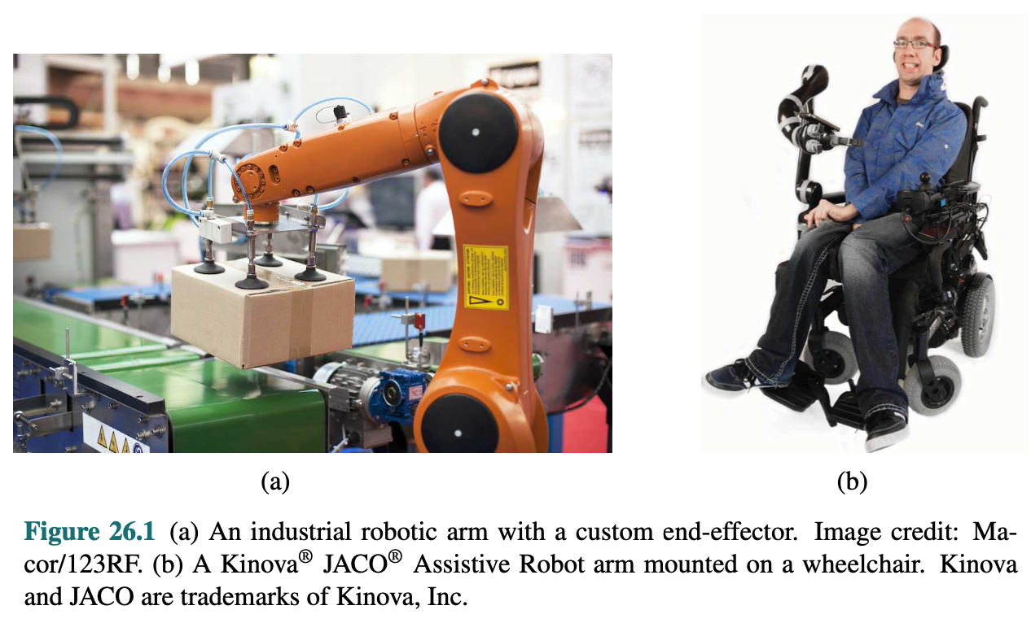
Robots for Manipulation and Transportation
<출처> Stuart J. Russell and Peter Norvig (2021). Artificial Intelligence: A Modern Approach (4th Edition). Pearson

Slide 6
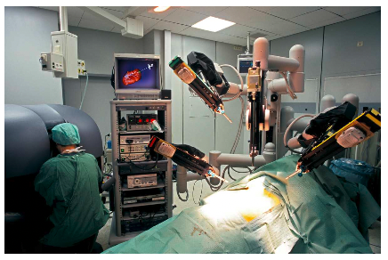
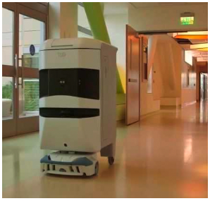
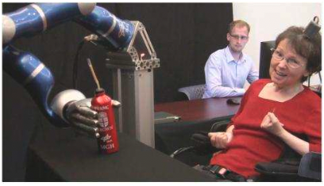
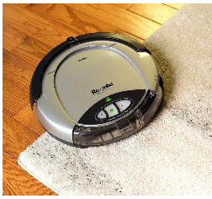
Applications of Robotics in Daily Life
Homecare
Brain-Machine Interfaces
Healthcare
Services
Autonomous Transportation
Entertainment
Hazardous Environments
Exploration to Mars
Industry

Slide 7
Outline (Lecture ##)
20.1 Robots …………..………….…………...………………………..
20.2 Robot Hardware ……….……………………….….....………..…
20.3 What kind of problem is robotics solving? ………….....……..….
20.4 Robotic Perception …………………………..….…….….……....
20.5 Planning and Control …………………………………………….
20.6 Planning Uncertain Movements …………………………………
20.7 Reinforcement Learning in Robotics …………………….………
20.8 Humans and Robots ……………………………………………...
20.9 Alternative Robotic Frameworks ………………………………...
20.10 Application Domains …………………………………………...
Summary ………………………………………………………………
7
10
16
20
30
39
41
44
49 52 56

Slide 8
20.1 Robots

Slide 9
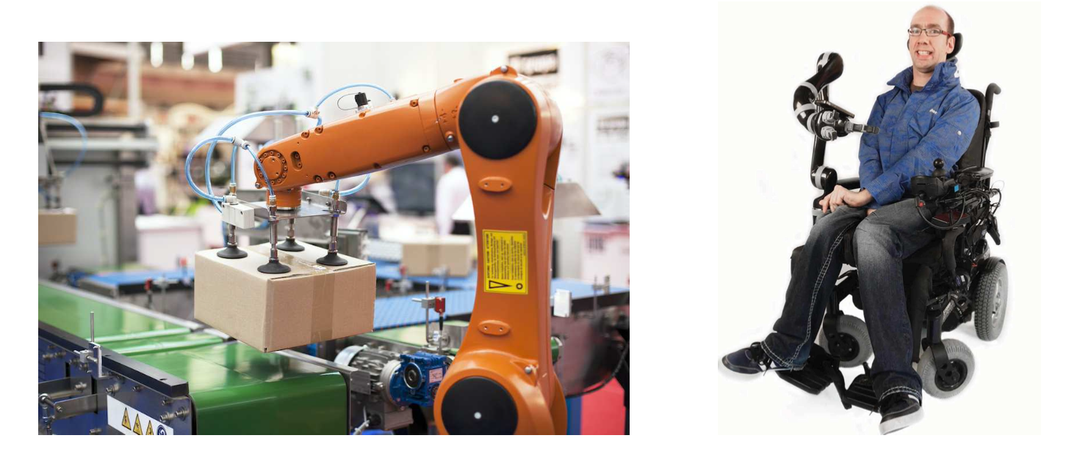
20.1 Robots (1/2)
What are robots?
Robots
Physical agents that perform tasks by manipulating the physical world.
To do so, they are equipped with:
(1) Effectors: To assert physical forces on the environment
(2) Sensors: To perceive their environment.

Slide 10
20.1 Robots (2/2)
What are robots? (cont’d)
Maximizing expected utility = Choosing how to actuate its effectors to assert the right physical forces.
Robot operate in partially observable and stochastic environment.
Cameras cannot see around corners, and gears can slip.
Other agents in the same environment are unpredictable.
Robot usually model their environment with a continuous action space.
Robot’s position has continuous coordinates.
Amount of current a robot sends to its motor is measured in continuous units.

Slide 11
20.2 Robot Hardware

Slide 12
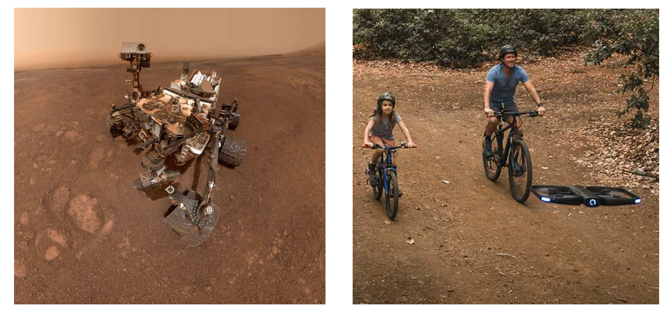
20.2 Robot Hardware (1/5)
Types of Robots
Manipulators (robot arms)
Physically anchored to their workspace
Most common type of industrial robots
Mobile robots
Move around the environment using wheels, legs, etc.
Other types of robots
Prostheses, exoskeletons, robots with wings, swarms.
<출처> Stuart J. Russell and Peter Norvig (2021). Artificial Intelligence: A Modern Approach (4th Edition). Pearson

Slide 13
20.2 Robot Hardware (2/5)
Sensing the World
Sensors are the perceptual interface between robot and environment.
Passive sensors
Capture signals that are generated by other sources in the environment. E.g. camera sensors.
Active sensors
Send energy into the environment and receive the reflected energy. E.g. sonar sensors
Sonar sensors
Active range finders that emit directional sound waves, which are reflected by objects, with some of the sound making it back to the sensor.

Slide 14
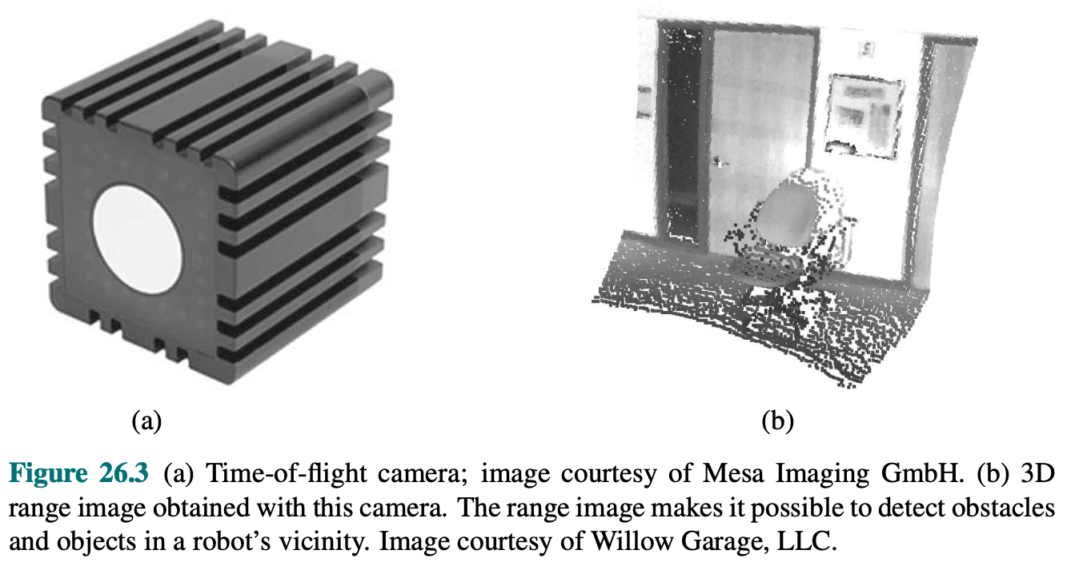
20.2 Robot Hardware (3/5)
Optical Range Sensors
Active optical range finders: Measure the time until
a reflection of signal arrives back at the sensor.
Time-of-flight camera: acquires range images
Lidar (light detection and ranging): emit laser beams and sense the reflected beam
Kinect is a low-cost sensor that combines camera and a structured light projector.
Projects a pattern of grid lines onto a scene.
The camera sees how the grid lines bend, giving information about the objects.
<출처> Stuart J. Russell and Peter Norvig (2021). Artificial Intelligence: A Modern Approach (4th Edition). Pearson

Slide 15
20.2 Robot Hardware (4/5)
Types of Sensors
Radar: Range finding sensor that measure distances up to kilometers and see through fog.
Tactile sensors: whiskers, touch-sensitive skin
Location sensors: Use range sensing to determine location.
E.g. Global positioning system (GPS)
Proprioceptive sensors: Inform the robot of its own motion
Equipped with shaft decoders that measure the angular motion of a shaft.
Shaft decoders: measure the angular motion of a shaft. Reports wheel revolutions for odometry.
Inertial sensors: Rely on the resistance of mass to the change of velocity.
E.g. Gyroscopes.
Force sensors and torque sensors: Inform the robot of its own motion.

Slide 16
20.2 Robot Hardware (5/5)
Actuators
Mechanism that indicates the motion of an effector.
Electric actuators: electricity to spin up a motor
Hydraulic actuators: pressurized hydraulic fluid (oil, water)
Pneumatic actuators: compressed air
Joints, which connect rigid bodies (links)
Revolute joints: One like rotates with respect to the other.
Prismatic joints: One link slides along the other.
Grippers: Most basic gripper is the parallel jaw gripper.
Equipped with two fingers and a single actuator that moves the fingers together to grasp objects.

Slide 17
20.3 What Kind of Problem Is Robotics Solving?

Slide 18
20.3 What Kind of Problem Is Robotics Solving? (1/3)
What are we trying to solve?
Agent that drives the hardware to achieve our goals.
Step 1. Decide the computational framework for the agent.
Step 2. Instantiate its ingredients: states, actions, reward or utility functions, observation spaces, etc.
Usually, the robot is acting in service of a human.
For most robot settings, the true reward function lies with the user.
However, there is a huge gap between low-level percepts and motor controls, and high-level plans the robot needs to make.

Slide 19
20.3 What Kind of Problem Is Robotics Solving? (2/3)
Three-level hierarchy
In robotics, we often use three level hierarchy.
Task planning
Decides a plan or policy for high level actions.
Motion planning
Finding a path that gets the robot from one point to another, achieving each subgoal.
Control
Achieve the planned motion using the robot’s actuators.
Since task planning is defined over discrete states and actions, this chapter focus primarily on motion planning and control.

Slide 20
20.3 What Kind of Problem Is Robotics Solving? (3/3)
Preference learning estimates an end user’s objective, and people prediction is used to forecast the actions of other people in the robot’s behavior.
Actions help improve perception and determine what kind of perception is useful.
Decisions at the motion level might not be the best when explaining how the motion will be tracked.
Decisions at the task level might render the task plan un-instantiatable at the motion level.
Progress in each area enables reintegration of tasks.
Robotics today is about continuing progress in each area while also building on this progress to achieve better integration.

Slide 21
20.4 Robotic Perception

Slide 22
20.4 Robotic Perception (1/9)
Robotic Perception
Perception is the process by which the robot maps sensor measurements into internal representations of the environment.
Perception is difficult because sensors are noisy, and environment is partially observable.
Good internal representations of robots have three properties:
(1) They contain enough information for the robot to make good decisions.
(2) They are structured so that they can be updated efficiently.
(3) They are natural in the sense that internal variables correspond to natural state variables in the physical world.

Slide 23
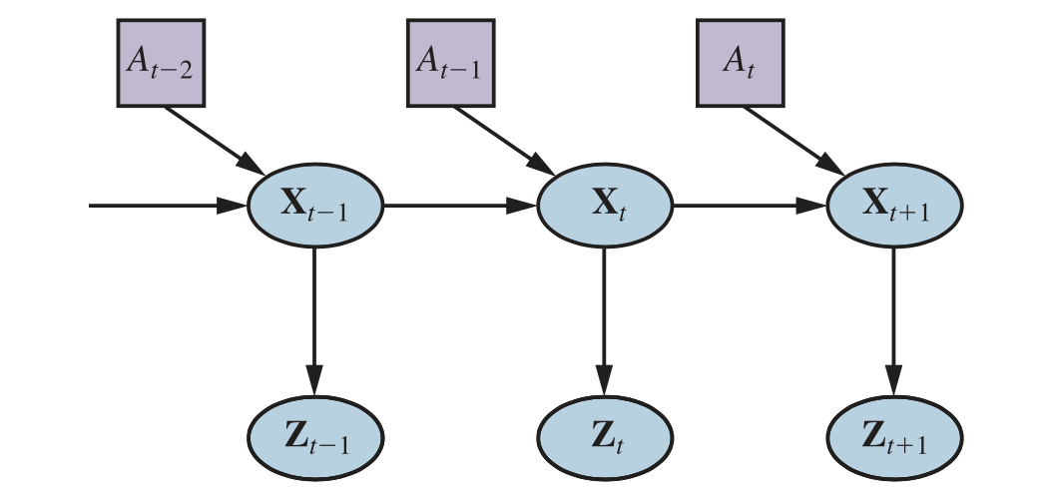
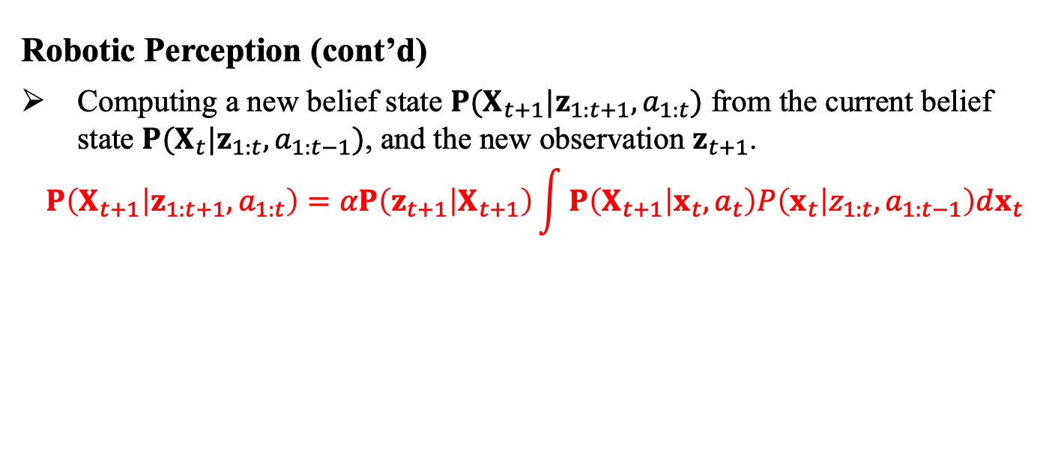
20.4 Robotic Perception (2/9)
Robotic Perception (cont’d)
Computing a new belief state $P(X_{t+1}|z_{1:t+1},a_{1:t})$ from the current belief state $P(X_{t}|z_{1:t},a_{1:t−1})$, and the new observation $z_{t+1}$.
$$P\left(X_{t+1} | z_{1:t+1},a_{1:t}\right)=αP\left(z_{t+1} | X_{t+1}\right)\int{P\left(X_{t+1} | x_{t},a_{t}\right)P\left(x_{t} | z_{1:t},a_{1:t−1}\right)dx_{t}}$$
new belief state
observation model
motion model
current belief state
<출처> Stuart J. Russell and Peter Norvig (2021). Artificial Intelligence: A Modern Approach (4th Edition). Pearson

Slide 24
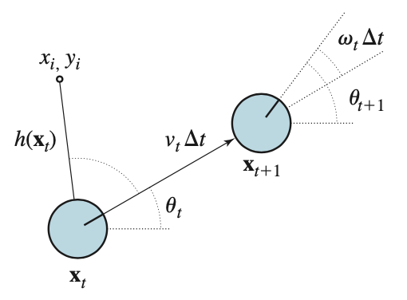
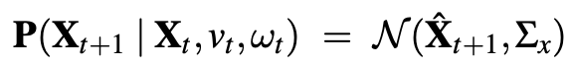
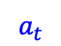
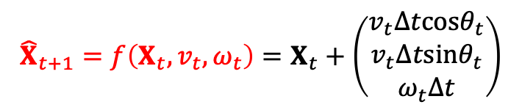
20.4 Robotic Perception (3/9)
Localization and Mapping: Motion Model
Localization: Problem of finding where things are – including robot itself.
The pose of robot is defined by two cartesian coordinates and its heading.
Motion model: Each action consists of “instantaneous” specification of two velocities, given a small-time intervals.
$${\hat{X}}_{t+1}=f\left(X_{t},v_{t}, ω_{t}\right)=X_{t}+\left(\begin{matrix}v_{t}∆tcosθ_{t} \\ v_{t}∆tsinθ_{t} \\ ω_{t}∆t\end{matrix}\right)$$
$$a_{t}$$
<출처> Stuart J. Russell and Peter Norvig (2021). Artificial Intelligence: A Modern Approach (4th Edition). Pearson

Slide 25
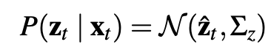
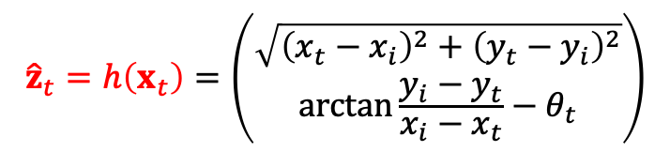
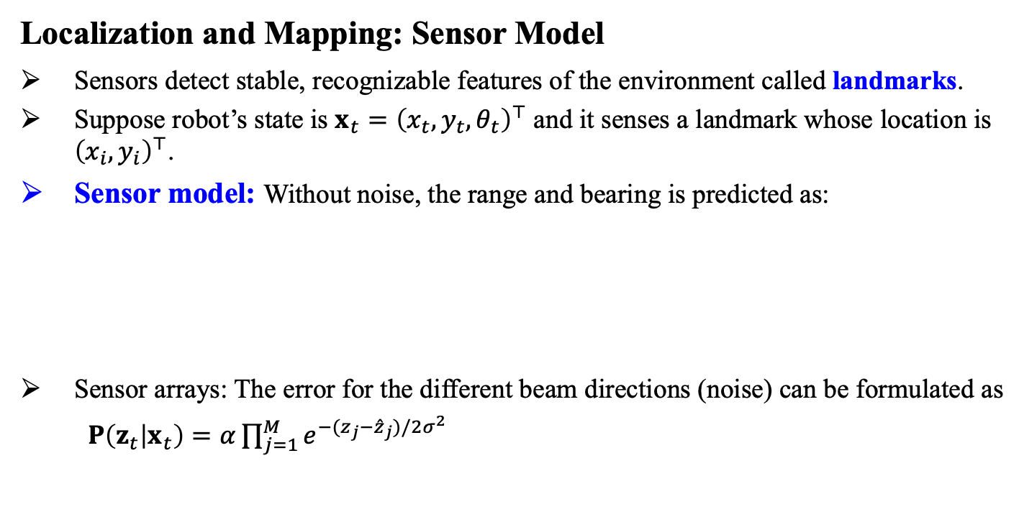
20.4 Robotic Perception (4/9)
Localization and Mapping: Sensor Model
Sensors detect stable, recognizable features of the environment called landmarks.
Suppose robot’s state is $x_{t}={\left(x_{t},y_{t},θ_{t}\right)}^{⊤}$ and it senses a landmark whose location is ${\left(x_{i},y_{i}\right)}^{⊤}$.
Sensor model: Without noise, the range and bearing is predicted as:
Sensor arrays: The error for the different beam directions (noise) can be formulated as
$P\left(z_{t} | x_{t}\right)=α\prod_{j=1}^{M}{e^{−(z_{j}−{\hat{z}}_{j})/2σ^{2}}}$
$${\hat{z}}_{t}=h\left(x_{t}\right)=\left({\sqrt{{\left(x_{t}−x_{i}\right)}^{2}+{\left(y_{t}−y_{i}\right)}^{2}} \atop arctan\frac{y_{i}−y_{t}}{x_{i}−x_{t}}−θ_{t}}\right)$$
<출처> Stuart J. Russell and Peter Norvig (2021). Artificial Intelligence: A Modern Approach (4th Edition). Pearson

Slide 26
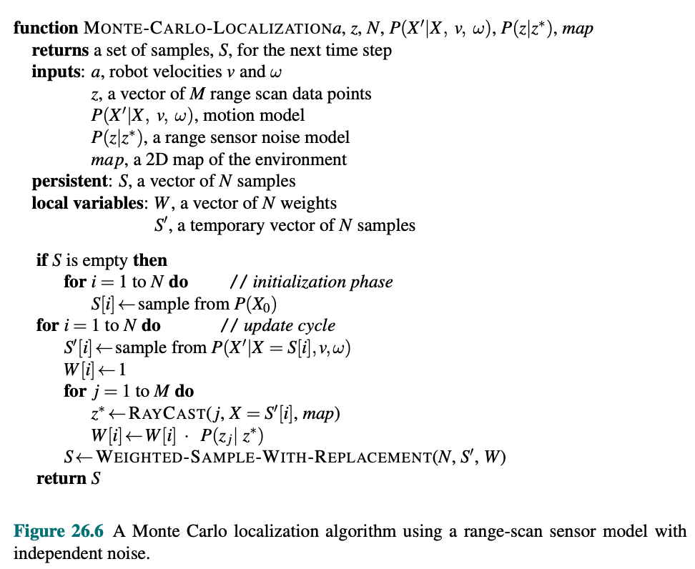
20.4 Robotic Perception (5/9)
Monte Carlo Localization (MCL)
Localization using particle filter
Particle filter represents the belief state by a collection of particles that correspond to states.
All we need to do is supply the appropriate motion model and sensor model.

Slide 27
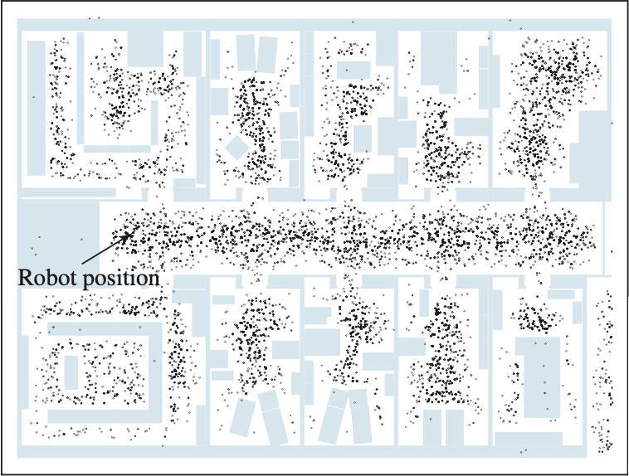
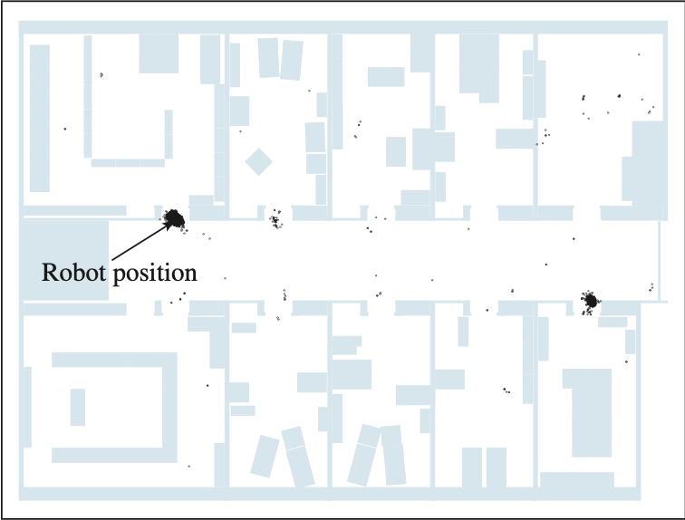
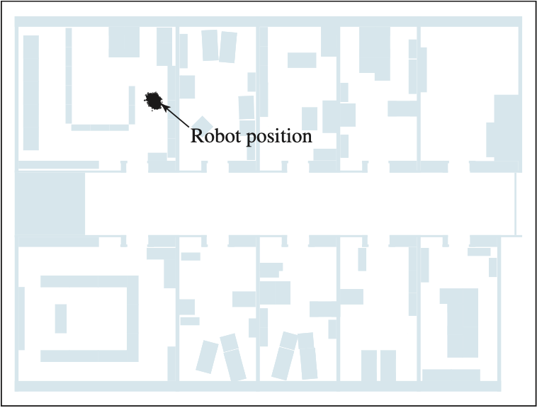
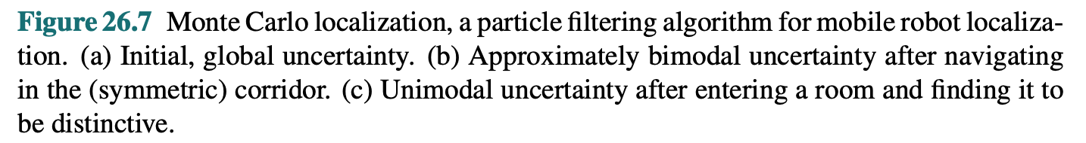
20.4 Robotic Perception (6/9)
Monte Carlo Localization (MCL): Particle Filter Algorithm

Slide 28
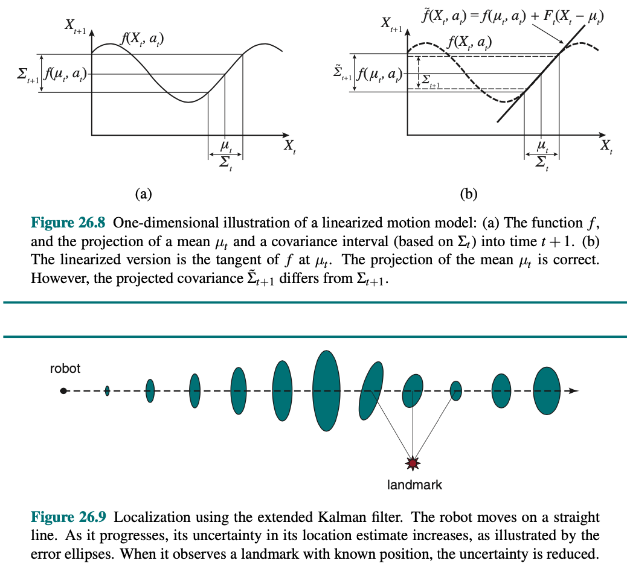
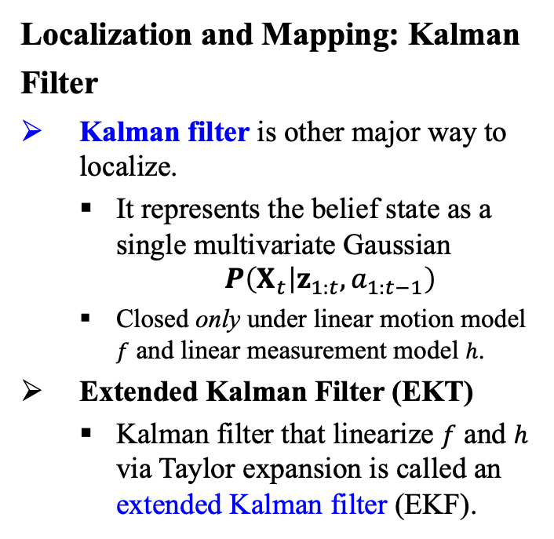
20.4 Robotic Perception (7/9)
Localization and Mapping: Kalman Filter
Kalman filter is other major way to localize.
It represents the belief state as a single multivariate Gaussian
$$P\left(X_{t} | z_{1:t},a_{1:t−1}\right)$$
Closed only under linear motion model $f$ and linear measurement model $h$.
Extended Kalman Filter (EKT)
Kalman filter that linearize $f$ and $h$ via Taylor expansion is called an extended Kalman filter (EKF).

Slide 29
20.4 Robotic Perception (8/9)
Simultaneous Localization and Mapping (SLAM)
As robot moves, the uncertainty in its location estimate increases.
Error decreases as it senses the range to a landmark with known location.
The problem is that we need to know the identity of landmarks.
In some situations no map of the environment is available. Then the robot has to acquire a map. This is a bit of a chicken-and-egg problem.
The navigation robot have to determine its location relative to a map it doesn’t quite know, at the same time building this map while it doesn’t really know its actual location
= Simultaneous Localization and Mapping (SLAM)
SLAM can be solved using many different probabilistic techniques, including extended Kalman filter (EKF).

Slide 30
20.4 Robotic Perception (9/9)
Other Types of Perception
Robots also perceive temperature, odors, sounds, and so on. These quantities can be estimated using variants of dynamic Bayes networks. It is also possible to program a robot as a reactive agent, without explicitly reasoning about probability distribution over states.
Supervised and Unsupervised Learning in Robot Perception
When internal representation is not known in robot perception, one common approach is to map high dimensional sensor streams into lower-dimensional spaces using unsupervised machine learning methods.
Low-dimensional embedding
Learn sensor and motion models from data, while simultaneously discovering a suitable internal representation.
Another technique is to continuously adapt changes in sensor measurements.
Adaptive perception techniques enable robots to adjust to such changes.
Methods that make robots collect their own data with labels are called self-supervised.

Slide 31
20.5 Planning and Control

Slide 32
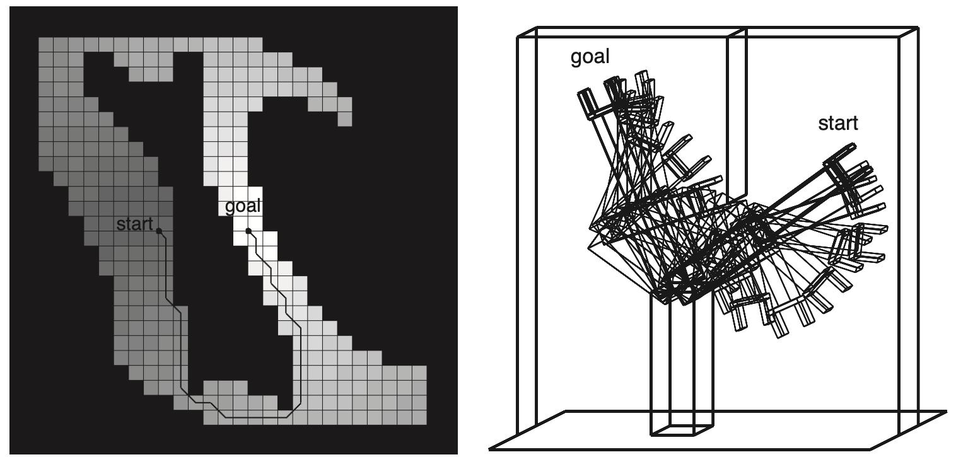
20.5 Planning and Control (1/8)
Path and Trajectory
Path is a sequence of points in geometric space that a robot will follow.
Motion planning: Task of finding a good path
Trajectory is a path that has a time associated with each point on the path.
Control: Once we have a path, the task of executing a sequence of actions to follow the path is called trajectory tracking control.

Slide 33
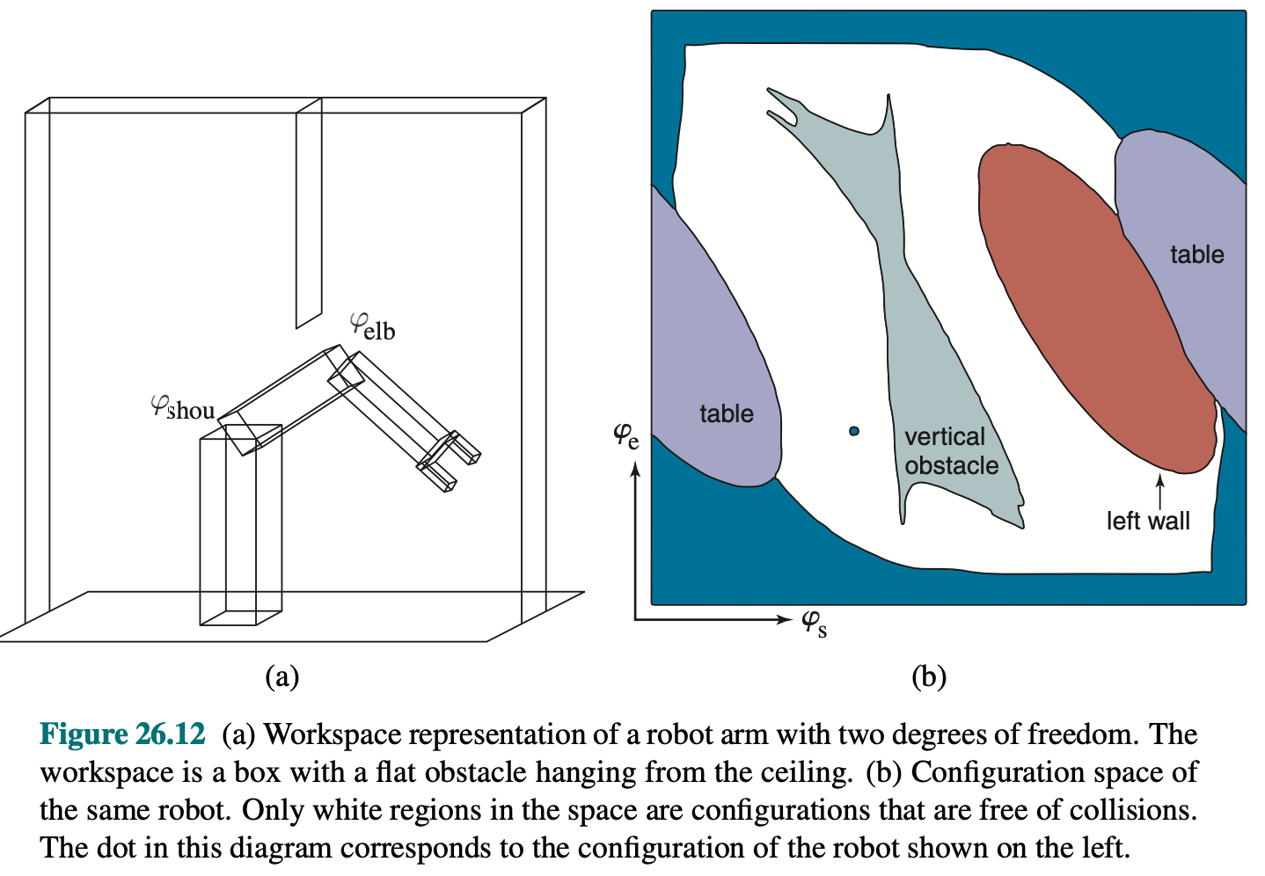
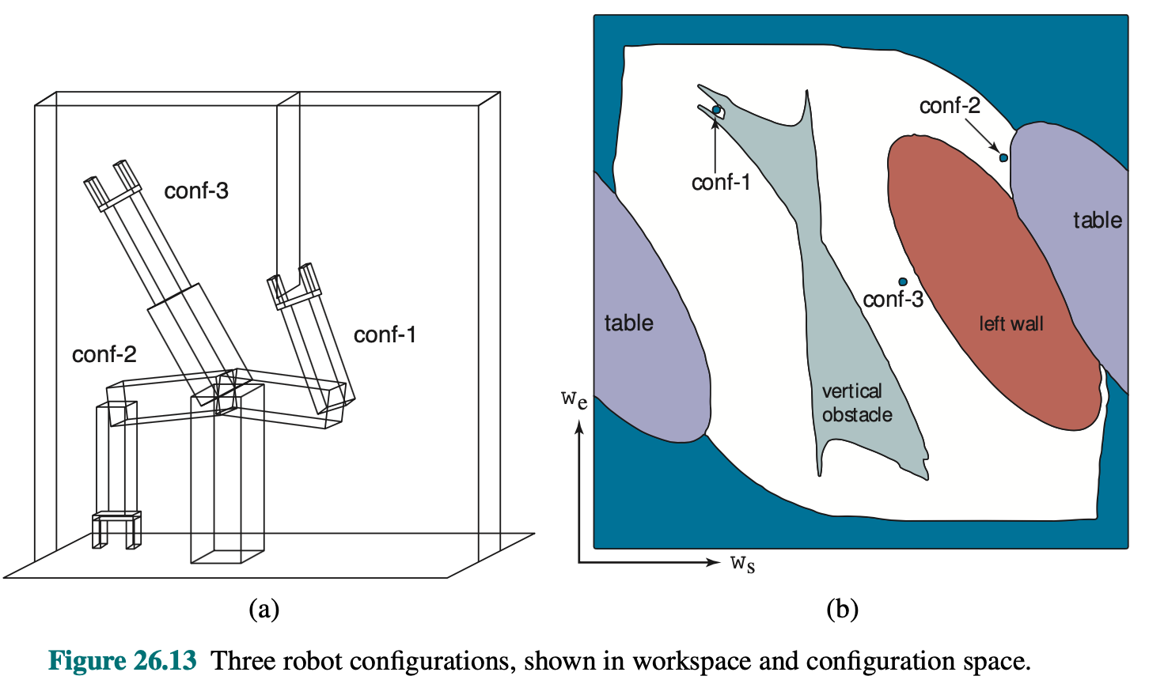
20.5 Planning and Control (2/8)
Configuration Space
Workspace: The physical space that a robot moves around.
Configuration space (C-space): All the points that comprise the robot are represented as a single point in multidimensional space
The set of points that comprise the robot can be computed if we know:
(1) Measurements of the robot
(2) Position and orientation
<출처> Stuart J. Russell and Peter Norvig (2021). Artificial Intelligence: A Modern Approach (4th Edition). Pearson

Slide 34
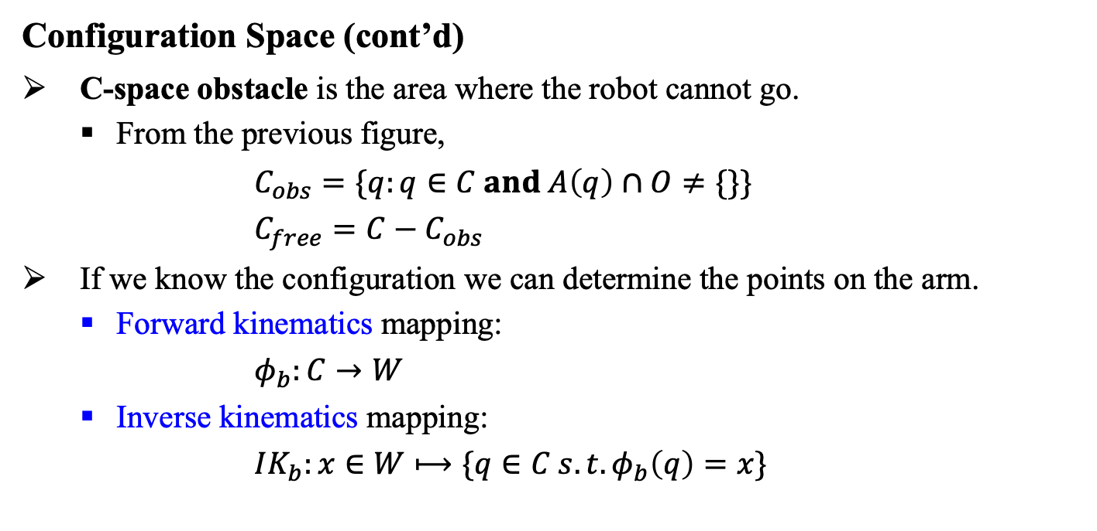
20.5 Planning and Control (3/8)
Configuration Space (cont’d)
C-space obstacle is the area where the robot cannot go.
From the previous figure,
$C_{obs}=\{q:q∈C and A\left(q\right)∩O≠\{\}\}$
${C_{free}=C−C}_{obs}$
If we know the configuration we can determine the points on the arm.
Forward kinematics mapping:
$φ_{b}:C→W$
Inverse kinematics mapping:
$IK_{b}:x∈W⟼\{q∈C s.t. φ_{b}\left(q\right)=x\}$

Slide 35
20.5 Planning and Control (4/8)
Motion Planning
Problem of finding a plan that takes a robot from one configuration to another without colliding with an obstacle.
Basic building block for movement and manipulation.
Motion planning is a quintessentially continuous-state search problem.
But is often possible to discretize the space and apply search algorithms.
It is also referred to as the piano mover’s problem.
The aim is to find a continuous path through free space, given C-space obstacle and its corresponding free space.

Slide 36
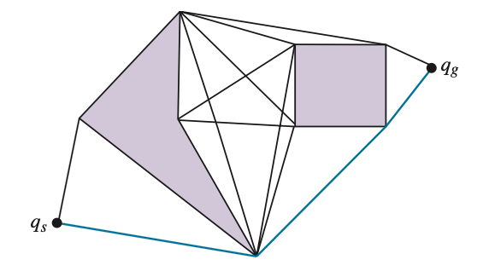
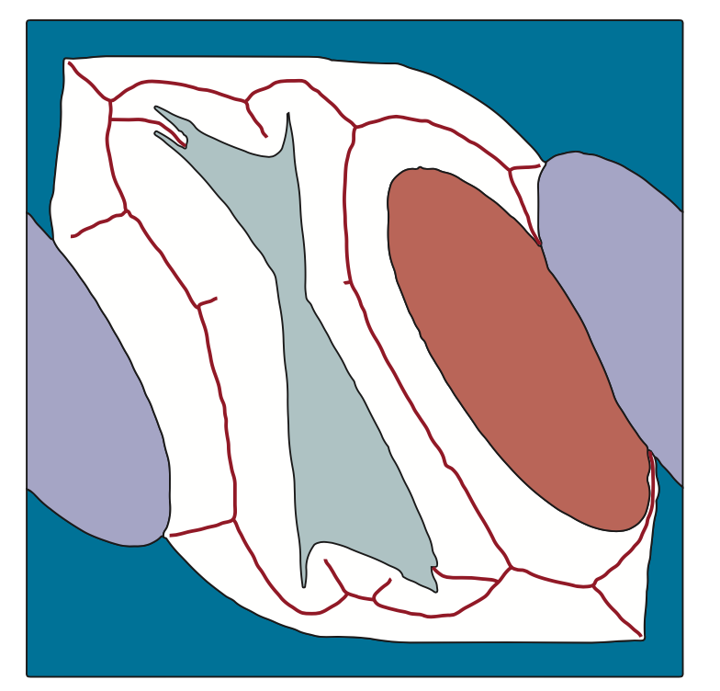
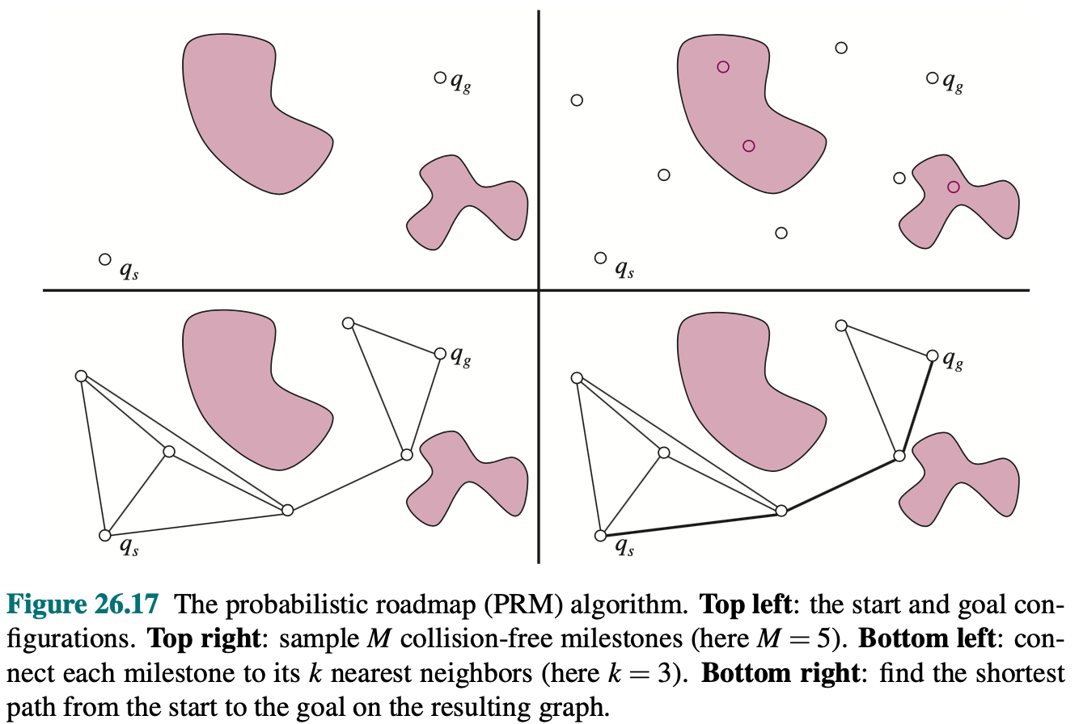
20.5 Planning and Control (5/8)
Motion Planning Methods
Visibility graphs
Voronoi diagrams
Put paths as far away from obstacles as possible
Calculates shortest path from a set of region consisting all the points in the plane that are closer to that obstacle point.
Probabilistic roadmap (PRM)
A skeletonization approach that offers more possible routes and deals with wide-open spaces.

Slide 37
20.5 Planning and Control (6/8)
Cell Decomposition
An alternative approach to motion planning is to discretize the C-space.
Cell decomposition methods decompose free space into a finite number of continuous regions, called cells.
Grayscale shading indicates the value of each free-space grid cell – the cost of the shortest path from the cell to the goal.
<출처> Stuart J. Russell and Peter Norvig (2021). Artificial Intelligence: A Modern Approach (4th Edition). Pearson

Slide 38
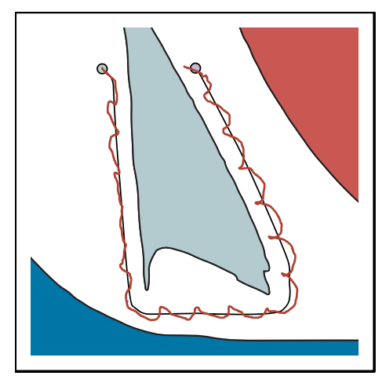
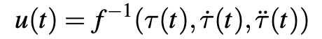
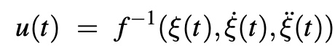
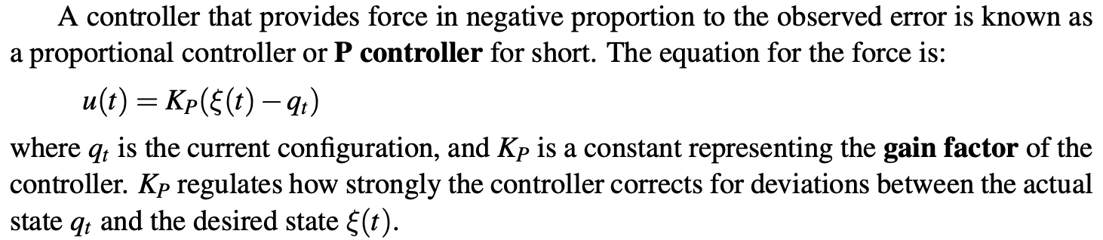
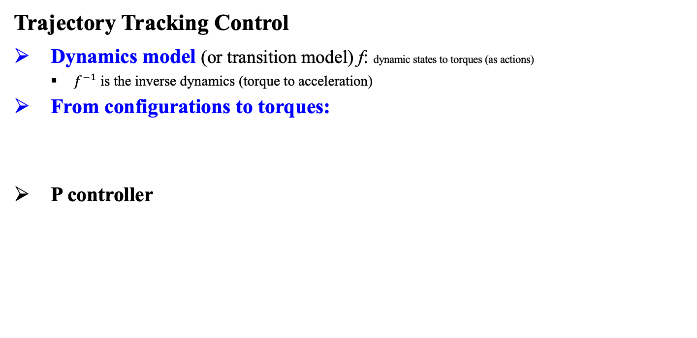
20.5 Planning and Control (7/8)
Trajectory Tracking Control
Dynamics model (or transition model) f: dynamic states to torques (as actions)
$f^{−1}$ is the inverse dynamics (torque to acceleration)
From configurations to torques:
P controller

Slide 39
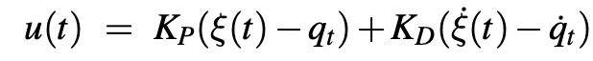
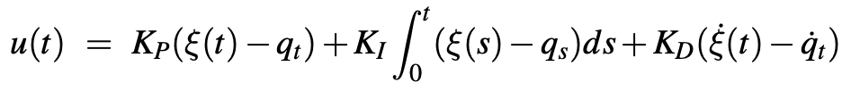
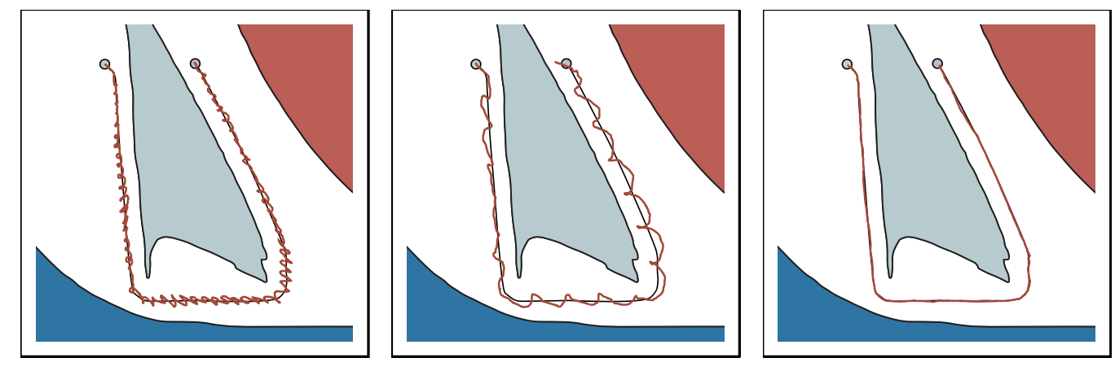
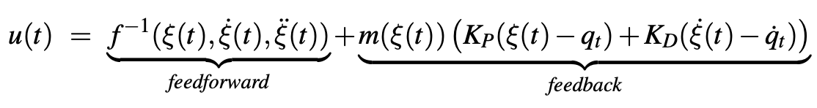
20.5 Planning and Control (8/8)
Trajectory Tracking Control (cont’d)
PD controller
PID controller
Proportional: Try harder the farther away you are from the path.
Integral: Try harder if you have not made progress for a long time.
Derivative: Try even harder if the error is increasing.
Computed torque control
Middle ground between open-loop control based on inverse kinematics and closed-loop PID control
<출처> Stuart J. Russell and Peter Norvig (2021). Artificial Intelligence: A Modern Approach (4th Edition). Pearson

Slide 40
20.6 Planning Uncertain Movements

Slide 41
20.6 Planning Uncertain Movements (1/1)
Online Planning
When tracking the plan designed for different hypothesis is too suboptimal, we do online planning, i.e.
Recompute a new plan based on the new belief.
Model Predictive Control (MPC)
Plan for a shorter time horizon, but replan every time step. MPC is related with real-time search and game-playing algorithms.
The plan effectively results in a policy: at every step, we run a planner and take a first action in the plan.
When we consider only the information we have and make a plan based on it, we are solving a new MDP at every step.

Slide 42
20.7 Reinforcement Learning in Robotics

Slide 43
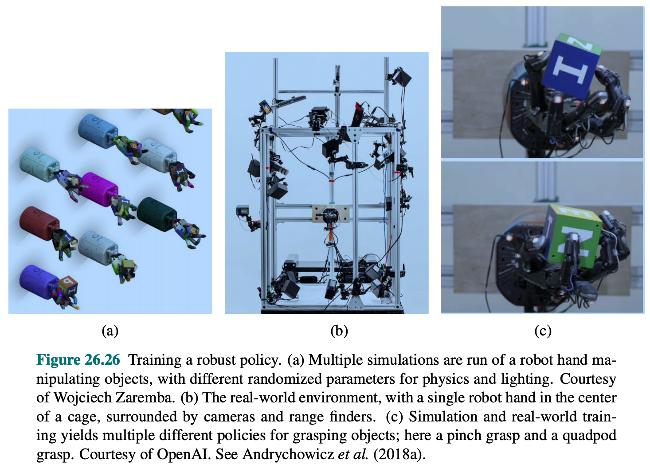
20.7 Reinforcement Learning in Robotics (1/2)
Exploiting Models
There are several ways to avoid the need for many real-world samples:
Model-based RL: Robot can alternate between fitting the dynamics parameters and computing a better policy.
Even if the equations are incorrect and fail, we learn from the error term.
Sim-to-Real: Transfer policies that work in simulation to real world.
To learn a policy that transfers, we add noise to the model during training.
We can also train policy using domain randomization.
End-to-End Learning: Policy takes pixels as input and directly outputs torques as actions.
Models can be exploited for the purpose of ensuring safe exploration.

Slide 44
20.7 Reinforcement Learning in Robotics (2/2)
Exploiting Other Information
When setting up an RL problem, we must select the state, action, policy, and the reward function. Possible approaches to making these decisions are:
Higher-level motion primitives
Motion primitive is a parameterized skill that the robot has.
Learns much faster than low-level approaches but does restrict the space of possible behaviors that the robot can learn.
Meta Learning or Transfer Learning
Reuse information from previous learning episodes on other tasks rather than starting from scratch.

Slide 45
20.8 Humans and Robots

Slide 46
20.8 Humans and Robots (1/4)
Main Challenges of Robot Planning and Learning
Coordination problem
Optimizing reward when there are people acting in the same environment as the robot.
Robots and humans require collaboration as robot’s reward depends on not just its own actions but also the action that people take.
Optimizing people’s wants
Reward function needs to incentivize the actions that people want the robot to execute.
Figuring out the right reward function or policy for the robot itself.

Slide 47
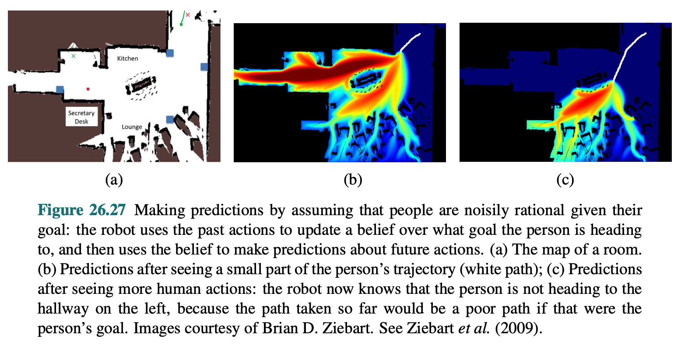
20.8 Humans and Robots (2/4)
Predicting Human Actions
<출처> Stuart J. Russell and Peter Norvig (2021). Artificial Intelligence: A Modern Approach (4th Edition). Pearson

Slide 48
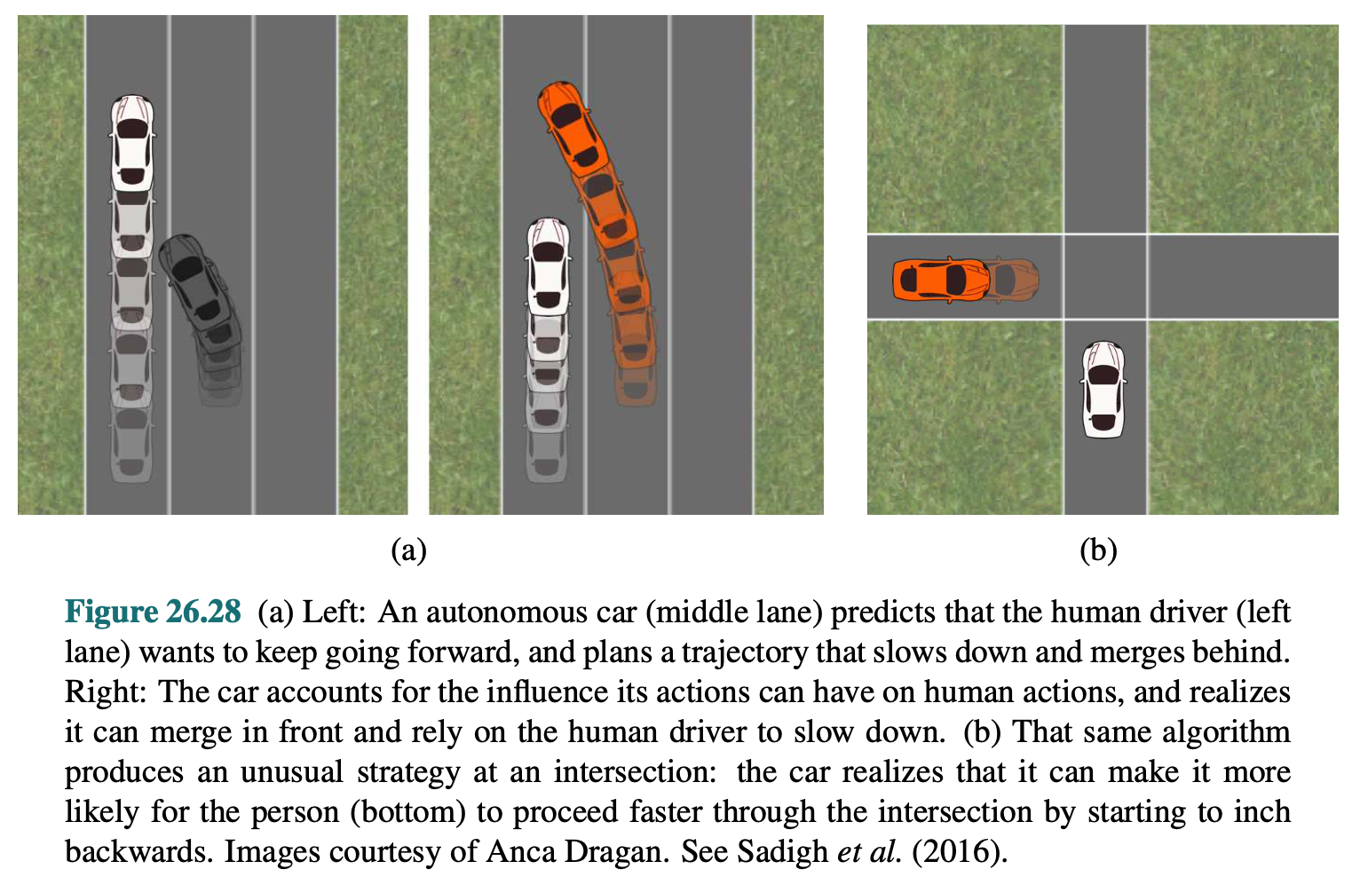
20.8 Humans and Robots (3/4)
Predicting Human Actions (cont’d)
<출처> Stuart J. Russell and Peter Norvig (2021). Artificial Intelligence: A Modern Approach (4th Edition). Pearson

Slide 49
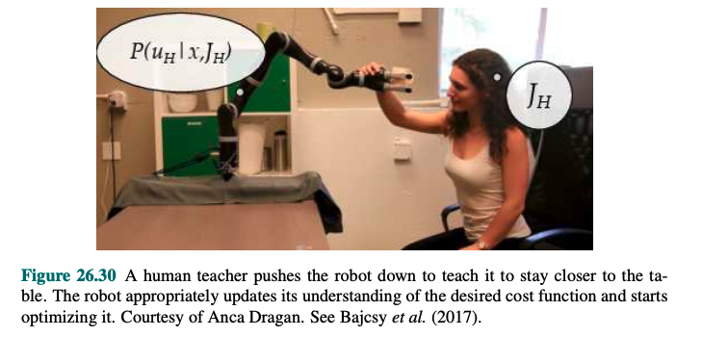
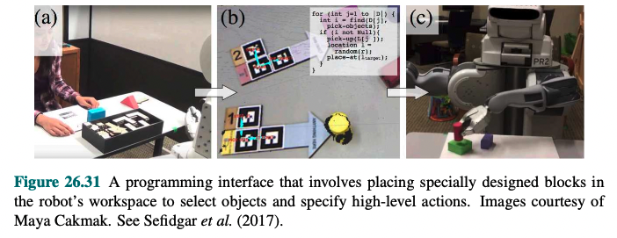
20.8 Humans and Robots (4/4)
Learning Policies Directly via Imitation
<출처> Stuart J. Russell and Peter Norvig (2021). Artificial Intelligence: A Modern Approach (4th Edition). Pearson

Slide 50
20.9 Alternative Robotic Frameworks

Slide 51
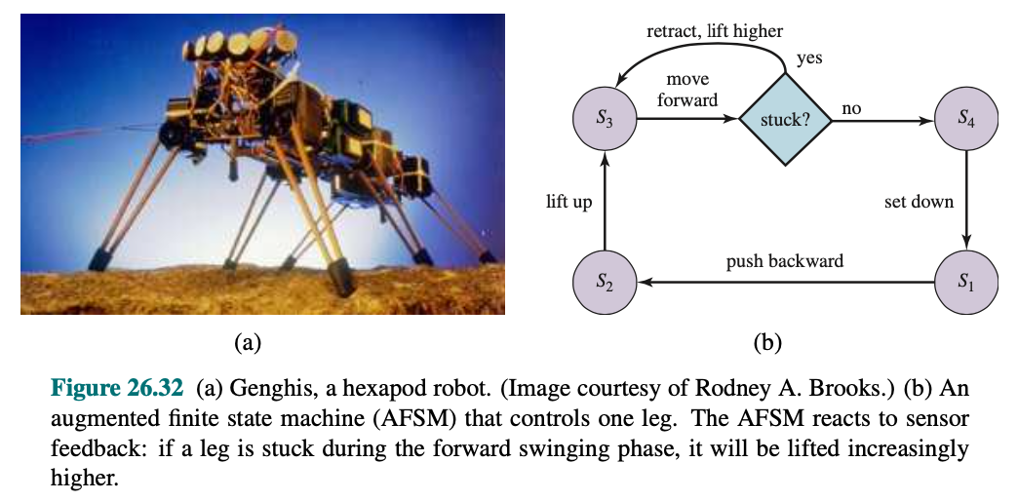
20.9 Alternative Robotic Frameworks (1/2)
Reactive Controllers
So far we have covered deliberative view of robotics. In some cases, a reflex agent architecture using reactive control is more appropriate.
When a leg’s forward motion is blocked, simply retract it, lift it higher, and try it again.
Behavior that emerges through the interplay of a simple controller is referred to as emergent behavior.
<출처> Stuart J. Russell and Peter Norvig (2021). Artificial Intelligence: A Modern Approach (4th Edition). Pearson

Slide 52
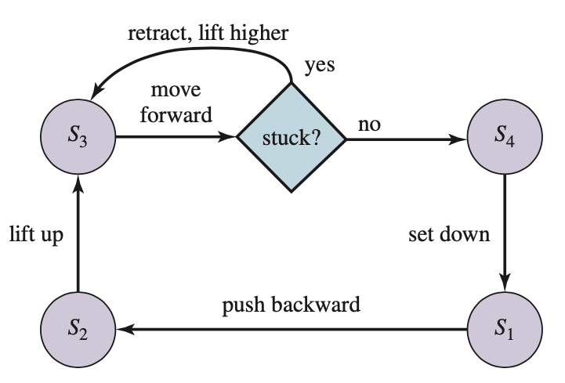
20.9 Alternative Robotic Frameworks (2/2)
Subsumption Architecture
A framework for assembling reactive controllers out of augmented finite state machines (AFSM).
An example of a simple AFSM is the four-state machine from the previous slide.
This AFSM implements a cyclic controller, whose execution mostly does not rely on environmental feedback.
The subsumption architecture offers additional primitives for synchronizing AFSMs, and for combining output values of multiple possible conflicting AFSMs.

Slide 53
20.10 Application Domains

Slide 54
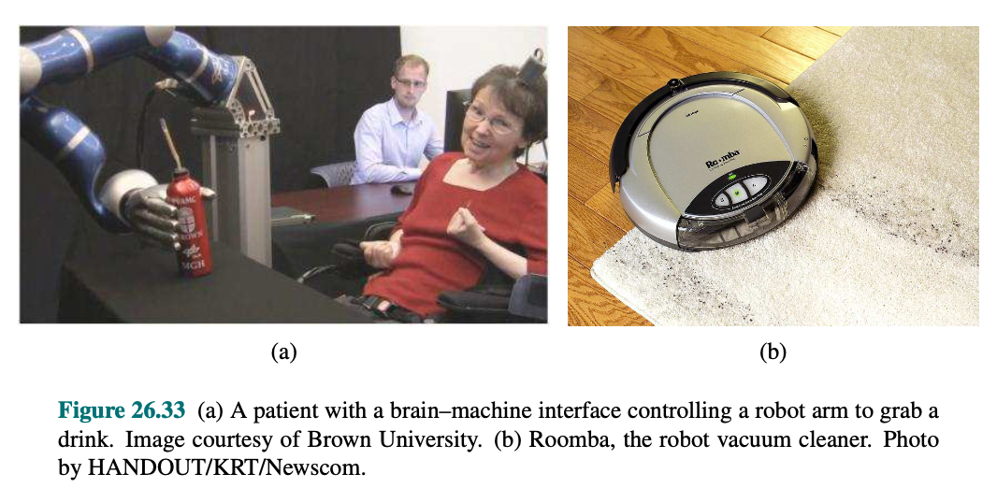

20.10 Application Domains (1/3)
Applications
Homecare
Assist older adults and people with motor impairments.
Enable them to live more independently.
Brain-Machine Interfaces
Enable people with quadriplegia to use a robot arm to grasp objects and even feed themselves.
Assist people with daily tasks like cleaning and organizing.
Health Care
Assist and augment surgeons, enabling more precise, minimally invasive, safer procedures with better patient outcomes.

Slide 55

20.10 Application Domains (2/3)
Applications (cont’d)
Services
Help in office buildings, hotels, and hospitals.
Use telepresence robots to attend meetings and conferences remotely.
Autonomous Transportation
Autonomous helicopters, wheelchairs, etc.
Tesla’s drive assist, which is meant for highway driving.
Entertainment
Autonomatronics, which generate autonomous actions.
Form of intelligent toys for children.

Slide 56

20.10 Application Domains (3/3)
Applications (cont’d)
Hazardous Environments
Cleaning up nuclear waste at Chernobyl and Three Mile Island.
Search and rescue at the World Trade Center.
Exploration
Sojourner to Mars
Robotic arms assist astronauts in deploying and retrieving satellites and in building the International Space Station.
Industry
Efficiently produce what society needs but displace some human workers from their jobs.

Slide 57
Summary
The most common types of robots are manipulators and mobile robots. They have sensors for perceiving the world and actuators that produce motion, which then affects the world via effectors.
The robot would solve the entire problem in one go: observations in the form of raw sensor feeds go in, and actions in the form of torques or currents to the motors come out.
Perception in robotics involves computer vision to recognize the surroundings through cameras, but also localization and mapping.
Probabilistic filtering algorithms such as particle filters and Kalman filters are useful for robot perception. These techniques maintain the belief state, a posterior distribution over state variables.
For generating motions, we use configuration spaces where a point specifies information we need to know to locate every body point on the robot.
We typically decouple the motion generation problem into motion planning, concerned with producing a plan, and trajectory tracking control, concerned with producing a policy for control inputs that results in executing the plan.
Planning under uncertainty unites perception and action by online planning.
Interaction with humans requires the ability to coordinate the robots' actions with theirs. We usually decompose the solution into perception.

